Slide 1
What is a tree?

Slide 2
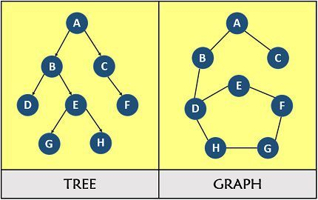
What is a graph?
A graph is a collection of vertices/nodes and the edges that connect them.
G = (V, E)
V = {A, B, C, D, E, F, G, H}
E = {(A,B),(A,C),(B,D),(B,E),(C,F),(D,H),(E,F),
(E,G),(G,H)} ← these are undirected edges

Slide 3
What is a tree?
A tree is a graph in which there is exactly one path connecting any two nodes.
T = (V, E)
V = {A, B, C, D, E, F, G, H}
E = {(A,B),(A,C),(B,D),(B,E),(C,F),(D,H),(E,F),
(E,G),(G,H)} ← these are directed edges

Slide 4
Binary Tree
A binary tree is one where each vertex can have a maximum of two children, distinctly labeled as a "left child" and a "right child," with edges connecting each parent vertex to its respective children

Slide 5
Binary Tree
A binary tree is a collection of nodes.
Each node has a data value and
references to two other nodes.
Each node could have a left child
and/or a right child.

Slide 6
Root →
50
Root is never a child.
It’s a parent / internal node or a leaf.
Every non-leaf node is a parent.
Parent →
( Internal
Node )
← Child
35
70
Non-root nodes are children.
22
41
81
Child/Leaf
Child/Leaf
Child/Leaf

Slide 7
Java Classes that
Use Binary Trees

Slide 8
TreeSet and TreeMap
TreeSet and TreeMap were built using binary trees.
1
2
3
4
5
6
7

Slide 9
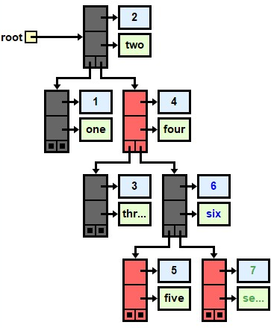
TreeMap
Map<Integer,String> map;
map = new TreeMap<>();
map.put(1,"one");
map.put(2,"two");
map.put(3,"three");
map.put(4,"four");
map.put(5,"five");
map.put(6,"six");
map.put(7,"seven");
System.out.println(map.get(1));
System.out.println(map.get(13));
System.out.println(map.get(7));
OUTPUT one null seven
Notes:
TreeSet and TreeMap were built using binary trees. Technically they’re red-black trees, which is a type of balanced tree.

Slide 10
Tree Attributes
90
50
120
40
65
100
150
30
45
70
95

Slide 11
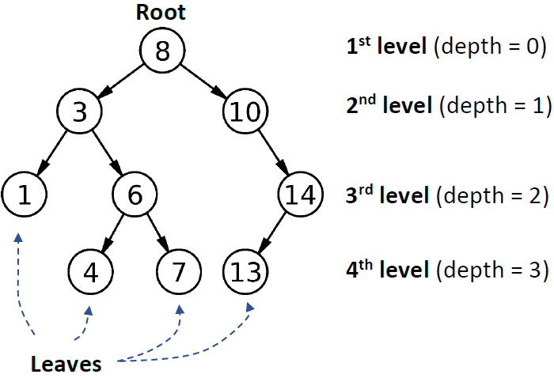
LEVEL = ROW = nodes with same height
NumLevels = 4

Slide 12
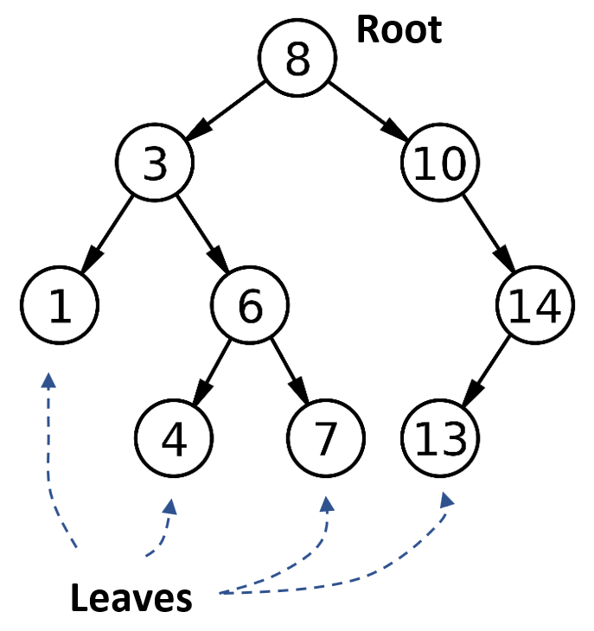
Num leaves:
Num parents:
Num children:
Num nodes:
4
5
8
9
Which is true?
# parents + # children = N
# parents + # leaves = N
Which is true?
# parents + # children = N
# parents + # leaves = N
Which is true?
1 + # children = N
# parents + # leaves = N
Notes:
Which is the complement to the number of parents, the number of children or the number of leaves? The number of leaves, b.c. 4 + 5 = 9

Slide 13
Types of
Binary Trees

Slide 14
Senses of “Full”
A node is full if it has two children.
A level is full if it contains its full capacity of nodes.
The first two rows of this tree are full.
The only node considered full is the root.
Notes:
Theorems: Let T be a nonempty, full binary tree. Then:
(a) If T has I internal nodes (i.e. parent nodes), the number of leaves is L = I + 1.
(b) If T has I internal nodes, the total number of nodes is N = 2I + 1.
(c) If T has a total of N nodes, the number of internal nodes is I = (N – 1)/2.
(d) If T has a total of N nodes, the number of leaves is L = (N + 1)/2.
(e) If T has L leaves, the total number of nodes is N = 2L – 1.
(f) If T has L leaves, the number of internal nodes is I = L – 1.

Slide 15
A Complete Tree
In a complete tree, every level above the bottom level is filled. The bottom level has all nodes shifted as far left as possible.

Slide 16
A Full
BINARY TREE
A full / proper binary tree is strictly binary, i.e. every node has exactly two children or no children at all.
Equivalently: every parent is full.
Notes:
Theorems: Let T be a nonempty, full binary tree. Then:
(a) If T has I internal nodes (i.e. parent nodes), the number of leaves is L = I + 1.
(b) If T has I internal nodes, the total number of nodes is N = 2I + 1.
(c) If T has a total of N nodes, the number of internal nodes is I = (N – 1)/2.
(d) If T has a total of N nodes, the number of leaves is L = (N + 1)/2.
(e) If T has L leaves, the total number of nodes is N = 2L – 1.
(f) If T has L leaves, the number of internal nodes is I = L – 1.

Slide 17
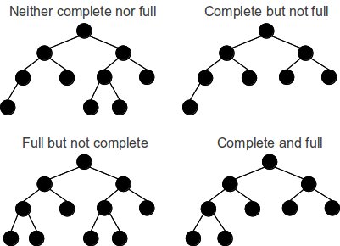
Neither complete nor full
Complete but not full
Full but not complete
Both complete and full

Slide 18
A Perfect
BINARY TREE
A perfect binary tree is a complete binary tree with the last level also filled completely.

Slide 19
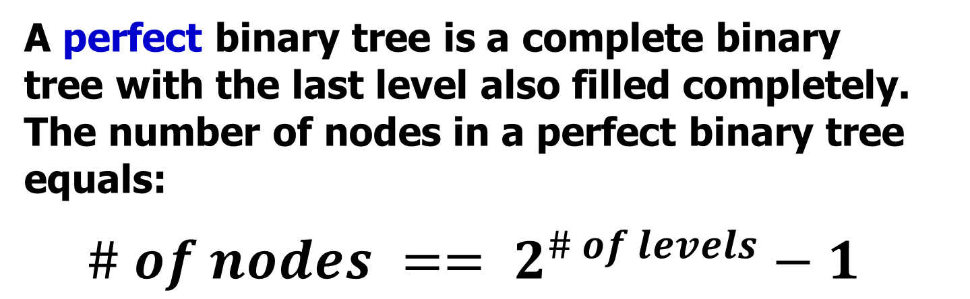
A Perfect
BINARY TREE
A perfect binary tree is a complete binary tree with the last level also filled completely. The number of nodes in a perfect binary tree equals:
$$\# of nodes == 2^{\# of levels}−1$$
There are 7 nodes:
2^{(3 levels)} – 1 = 7

Slide 20
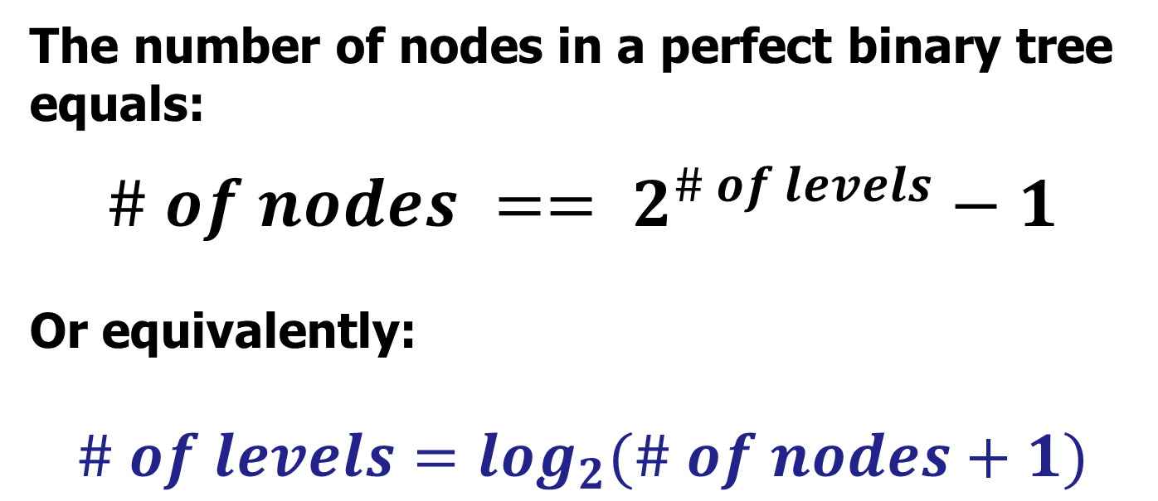
A Perfect
BINARY TREE
The number of nodes in a perfect binary tree equals:
$$\# of nodes == 2^{\# of levels}−1$$
Or equivalently:
$$\# of levels=\log_{2}(\# of nodes+1)$$
Notes:
Note that some will write the formula using the HEIGHT instead of the # of LEVELS.

Slide 21
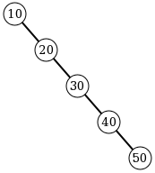
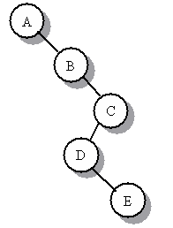
A degenerate binary tree
A tree where each parent node has only one associated child node. This means that performance-wise, the tree will behave like a linked list.

Slide 22
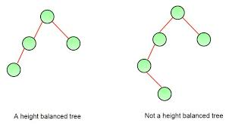
A binary tree is balanced if the absolute difference between heights of left and right subtrees at any node is at most 1.

Slide 23
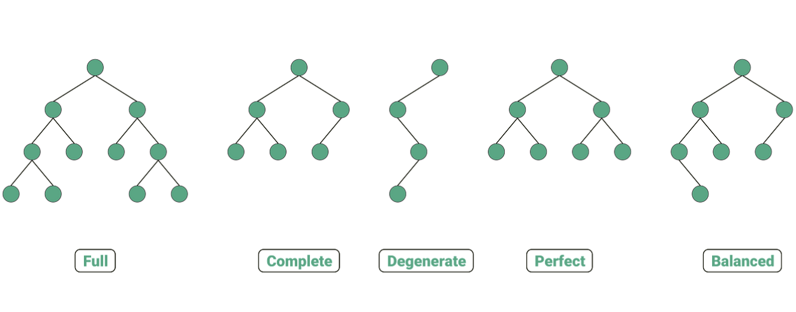
Types of Binary Trees

Slide 24
Binary
Search
Trees

Slide 25
Binary Search Tree
a binary tree in which:
there are no duplicate values
every left child’s data is less than the data in its parent
every right child’s data is greater than the data in its parent

Slide 26
Binary
Search
Tree
Root
left child is
less than the
parent and
right child
is greater
50
35
70
22
41
81

Slide 27
Binary Search Tree (BST)
In other words, for every node:
All nodes in the left subtree have values that are less than the value in that node, and
All values in the right subtree are greater.
5
< 5
2
8
> 5
0
3
7
9

Slide 28
Which of the trees shown are legal binary search trees?
m
-5
✓
42
?
?
?
g
q
-1
-7
b
k
x
✓
e
7.2
?
1.9
9.6
8.1
21.3

Slide 29
Building a
BST

Slide 30
Building a BST
To insert a new item:
Pretend to look for the item
Put the new node in the place where you fall off the tree

Slide 31
Building a BST
Jayden

Slide 32
Building a BST
Jayden

Slide 33
Building a BST
Jayden
Fahad

Slide 34
Building a BST
Jayden
Fahad

Slide 35
Building a BST
Jayden
Fahad

Slide 36
Building a BST
Jayden
Marvin
Fahad

Slide 37
Building a BST
Jayden
Fahad
Marvin

Slide 38
Building a BST
Jayden
April
Fahad
Marvin

Slide 39
Building a BST
Jayden
April
Fahad
Marvin

Slide 40
Building a BST
Jayden
Fahad
Marvin
April

Slide 41
Building a BST
Jayden
Fahad
Marvin
April

Slide 42
Building a BST
Jayden
Fahad
march
April
June
Marvin
Carlos
Julio
Syed
Paolo
Naomi

Slide 43
Add Method
public void add(Comparable val) { root = add(val, root); } private TreeNode add(Comparable val,
TreeNode tree) {
}

Slide 44
Add Method
private TreeNode add(Comparable val,
TreeNode tree){ if(tree == null) return new TreeNode(val); Comparable treeValue = tree.getValue(); int dirTest = val.compareTo(treeValue); if(dirTest < 0) tree.setLeft(add(val, tree.getLeft())); else if(dirTest > 0) tree.setRight(add(val, tree.getRight())); return tree; }

